Slide 1
Notes:
Steve

Slide 2


Our Distinguished Guests this Evening
Our team is highly experienced in Wisconsin’s financial industry, assisting with research and development for disclosure documents, rating presentations and reports, continuing disclosure filings, coordinating closings, market research and analysis.
Our team operates under the management of Carol Ann Wirth, President and sole-owner of Wisconsin Public Finance Professionals, LLC. Carol is a professional with extensive experience in working exclusively in Wisconsin public finance. Carol:
Is MSRB and SEC Registered as a Municipal Advisor Representative (Series 50) and Municipal Advisor Principal (Series 54).
Is responsible for overall management of the firm and relationship manager.
Has over 40 years of experience working exclusively with Wisconsin municipalities and school districts to accomplish their public finance goals.
Has career experience in Wisconsin, which includes employment with various broker-dealer firms as a Registered Representative and a Registered Principal to manage their Public Finance Departments in Wisconsin.
Has comprehensive experience with and understanding of Wisconsin laws and Federal regulations governing public finance for all units of local government in Wisconsin (cities, counties, school districts, villages, towns, vocational districts, sanitary districts).
Has extensive experience with servicing Wisconsin local units of government – structuring options, customized financial plans, on-site bond rating assistance, and strong communication skills for committee, council, board and community group (referendum) presentations.

Slide 3
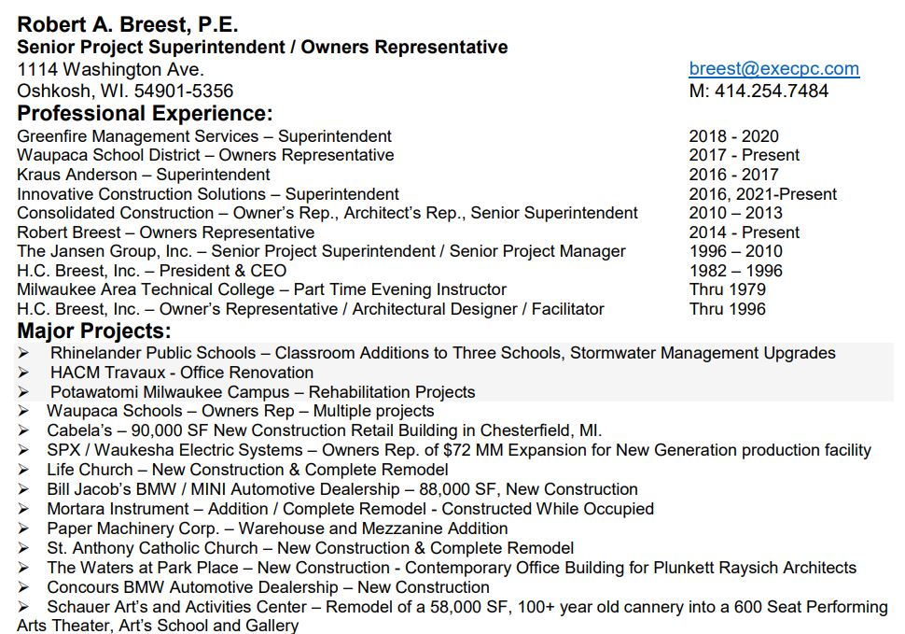
Bob Breest – Civil Engineer

Slide 4


DESIGN TEAM
STEVE KIECKHAFER
Principal, Architect
Educational Planner
MOLLY RYAN
Architect
Project Designer
Notes:
Molly

Slide 5

POINT OF ENTRY
Notes:
To use this title animation slide with a new image simply 1) move the top semi-transparent shape to the side, 2) delete placeholder image,
3) click on the picture icon to add a new picture, 4) Move semi-transparent shape back to original position, 5) Update text on slide.

Slide 6
THE SCHOOL DISTRICT OF WAUPACA’S
#1 AREA OF SAFETY
VULNERABILITY
WI SCHOOL SAFETY COORDINATIORS ASSOCIATION
THE U.S.DEPARTMENT OF JUSTICE
Notes:
To use this title animation slide with a new image simply 1) move the top semi-transparent shape to the side, 2) delete placeholder image,
3) click on the picture icon to add a new picture, 4) Move semi-transparent shape back to original position, 5) Update text on slide.

Slide 7
The Problem

Slide 8
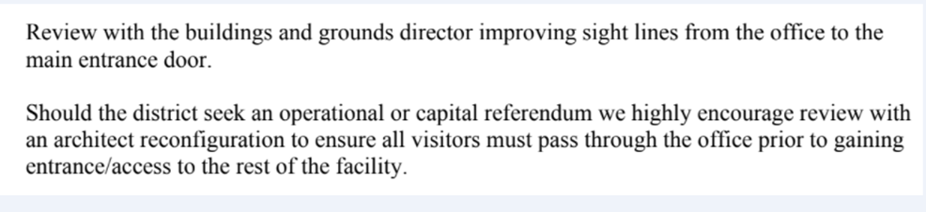
Waupaca Learning Center

Slide 9
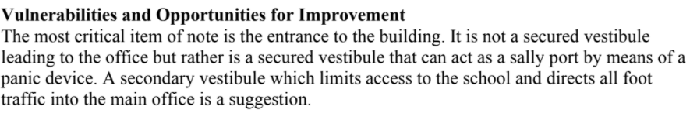
Middle School

Slide 10
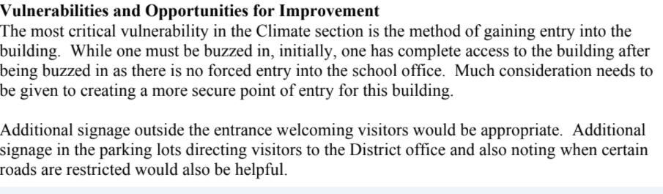
High School

Slide 11
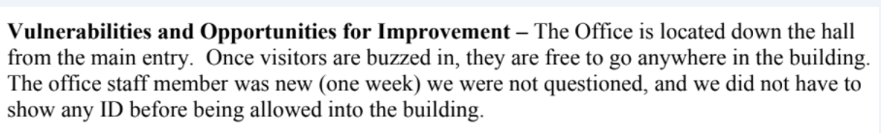
CEC

Slide 12
History
How did we get here?

Slide 13
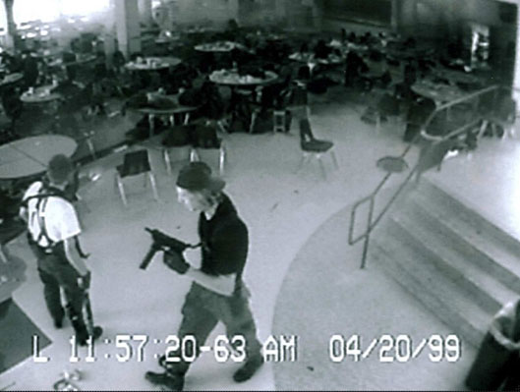
In 2019 the school district of Waupaca encountered two major school threats with the intent to do harm to the district’s students and staff population. The threat was so severe that this news was picked up on national news outlets.
The department of justice investigators who investigated the Pulse night club and Parkland High School shootings where 49 patrons and 17 high school students were killed in Florida came to Waupaca WI to review and re-educate all administration with regard to safety protocols.
In concert with the Department of Justice the Wisconsin School Safety Assessment Team were also onsite to conduct a safety audit of all the district’s safety protocols which included an assessment that deemed all of the district’s school building entryways were problematic requiring structural changes.

Slide 14
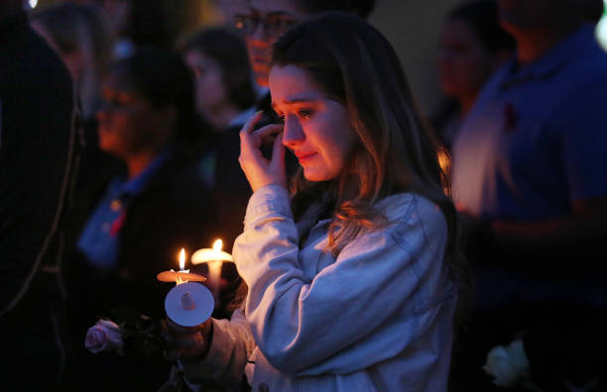
Since then the district has tightened up all safety protocols according to these assessments with each building having a safety team.
The Love you Guys Program which formulated after the infamous Colorado Columbine high school shooting is the districts internal safety protocol roadmap
Rally points for students, and reunification sites for parents and students are clearly defined, table top exercises with local law enforcement inclusive of staff members are continuous,
The hiring of two police liaison officers are now just part of the districts continuance of standard operating procedures culture.

Slide 15
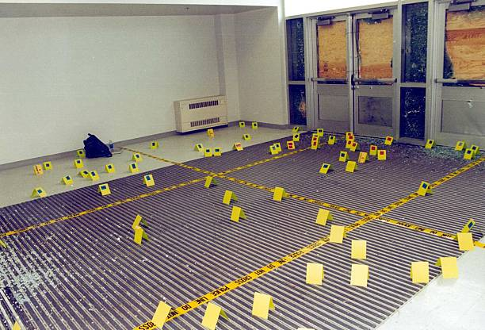
Arguably the districts number one safety concern, the number one aspect of the Department of Justice and WI School Safety Assessment left to resolve is the vulnerability of the district’s point of entry which is all building entryways
In November of 2021 after searching for architects who were experts in building safety protocols PRA Architects were selected and onsite with Building & Grounds Supervisor Matt Vassar, District Consultant Bob Breest Civil Engineer and myself in January of 2022 going through all of the districts school buildings viewing the current building entry way layouts and developing an understanding of the scope of the project having recently completed this similar work in WI Rapids school district.

Slide 16
What do the experts day?

Slide 17
Single point of entry to channel your security resources in a cost effective manner.
“Effective access control requires that entry to and from a building be controlled,” says Spicer.
“Efforts to prevent forced entry and trespass are compromised if secondary points of entry or fire doors are unsecure or easily defeated and not seen.”
While large school or university buildings may have multiple points of entry, the more entry points there are, the more expensive and duplicative the security efforts.
“The main point of entry should look and act like the primary entry point and not a fire egress door. It should be regulated with access control, surveillance and strong design features that resist breakage or compromise.”
By adopting these elements, you’ll be able to prevent the entry of unauthorized individuals or delay their access until law enforcement can be summoned.
Brad Spicer – Hospital/School/University Campus Safety

Slide 18
Multiple points of entry make it difficult to control who gains access to a school. By designing one main point of entry and reconfiguring other doors to be exit-only, building-access points can be better controlled. An automatic door-locking system should also be considered. When a threat is determined, a single button can be pushed to lock all or specific doors in the facility, eliminating easy access to classrooms.
In order to control building access during those times, we incorporated public entrances to certain areas. Using a combination of bold signage, lighting, and open-view corridors to the main street, we were able to successfully renovate this mixed-use campus with security top of mind.

Slide 19
The Physical Solution

Slide 20

Plunkett Raysich Architects LLC - PRA
Our Architects in compliance with best practice building design have redesigned all main safety checkpoint areas to keep predators whether it be potential school shooters, disgruntled family members of staff members, community members, joint custody battles or random individuals from entering the district’s general population to do something nefarious. WLC for example individuals are buzzed into the building from offices that are far removed from the building entryway by viewing a camera. Upon entering the building individuals are left to wander having multiple directions to move, a staircase going downstairs on both sides, or a staircase going upstairs like a deer hunting tree stand individuals could easily sit perched above having full access to WLC’s entire lunchroom like an open field. 700 students, 100 staff members, community members all become vulnerable to one individual who enters WLC in its current structural layout.

Slide 21

Tearing down support walls removing stair cases enclosing balconies going inward is costly perhaps as much as the building addition and WLC would lose its commons area its lunch room in the process. This is a large elementary school by Wisconsin standards and losing any internal space would be problematic for the reduction of space congesting all other areas of this school like a domino effect. Structurally a building addition to the front of the building where Point of Entry check points running through a defined reception area prior to entering the general population with offices up front alleviates the wild wild west approach of movement through the school building long term for future generations built right the first time.

Slide 22
PRA Remodeling & Renovation
Safety Plan Designs for each Building

Slide 23
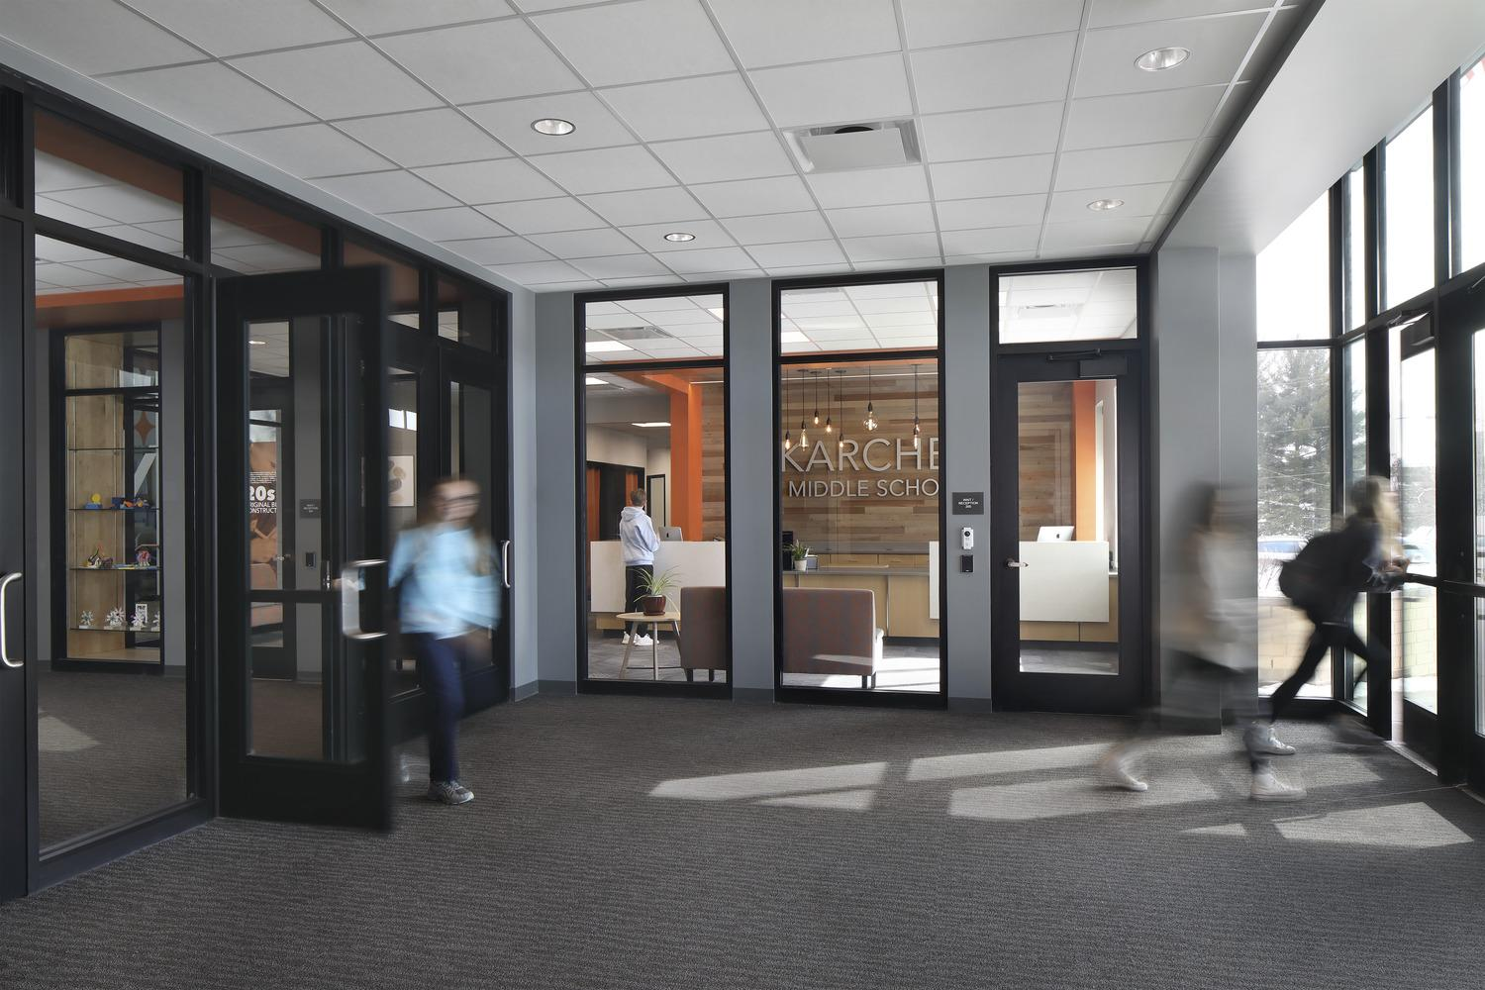
WHAT IS A SAFE & SECURE ENTRANCE
Notes:
Molly

Slide 24
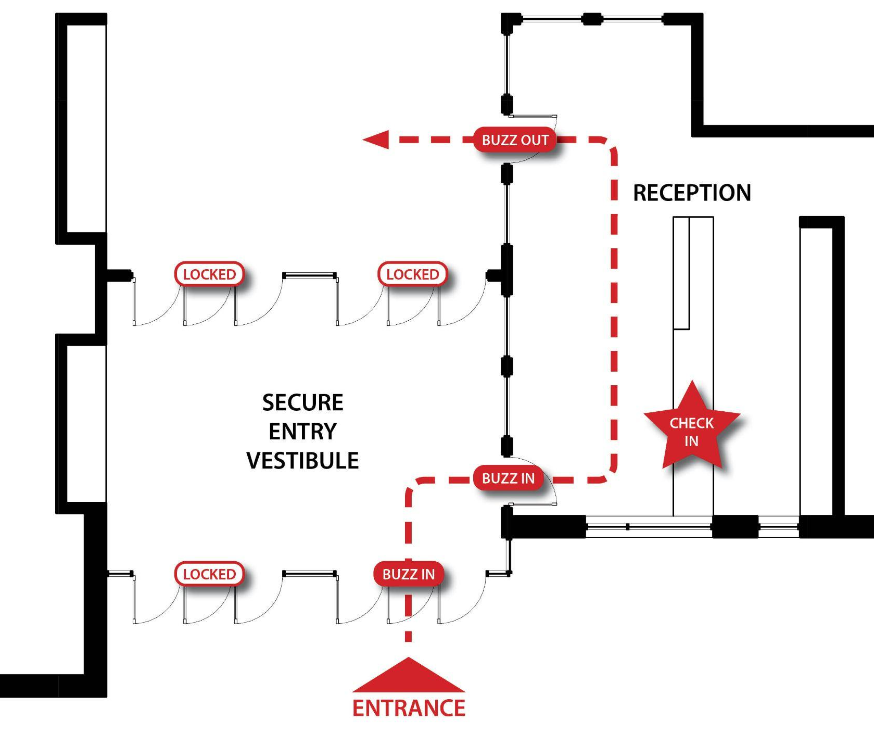
WHAT IS A SAFE & SECURE ENTRANCE
Notes:
Molly

Slide 25
WLC

Slide 26
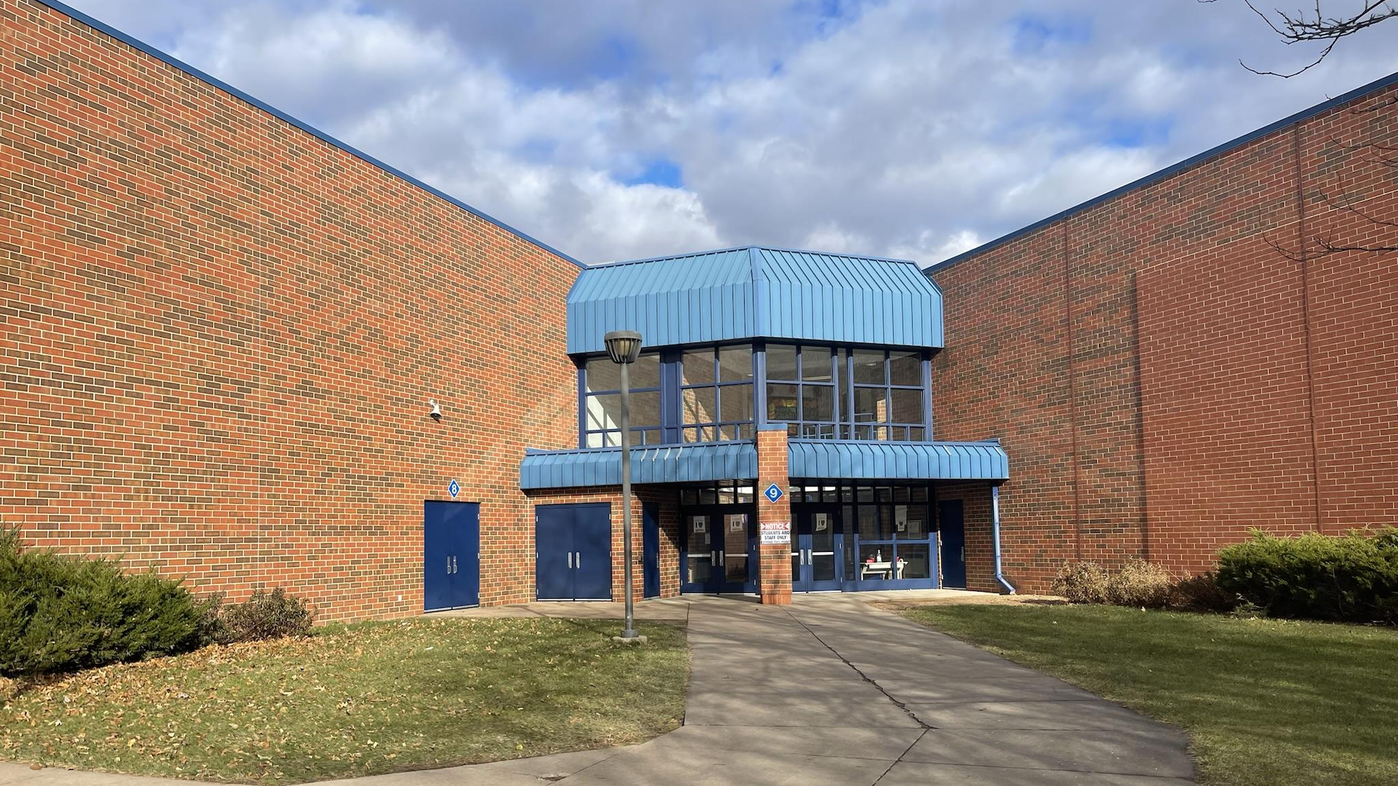
WAUPACA LEARNING CENTER
Notes:
Molly

Slide 29
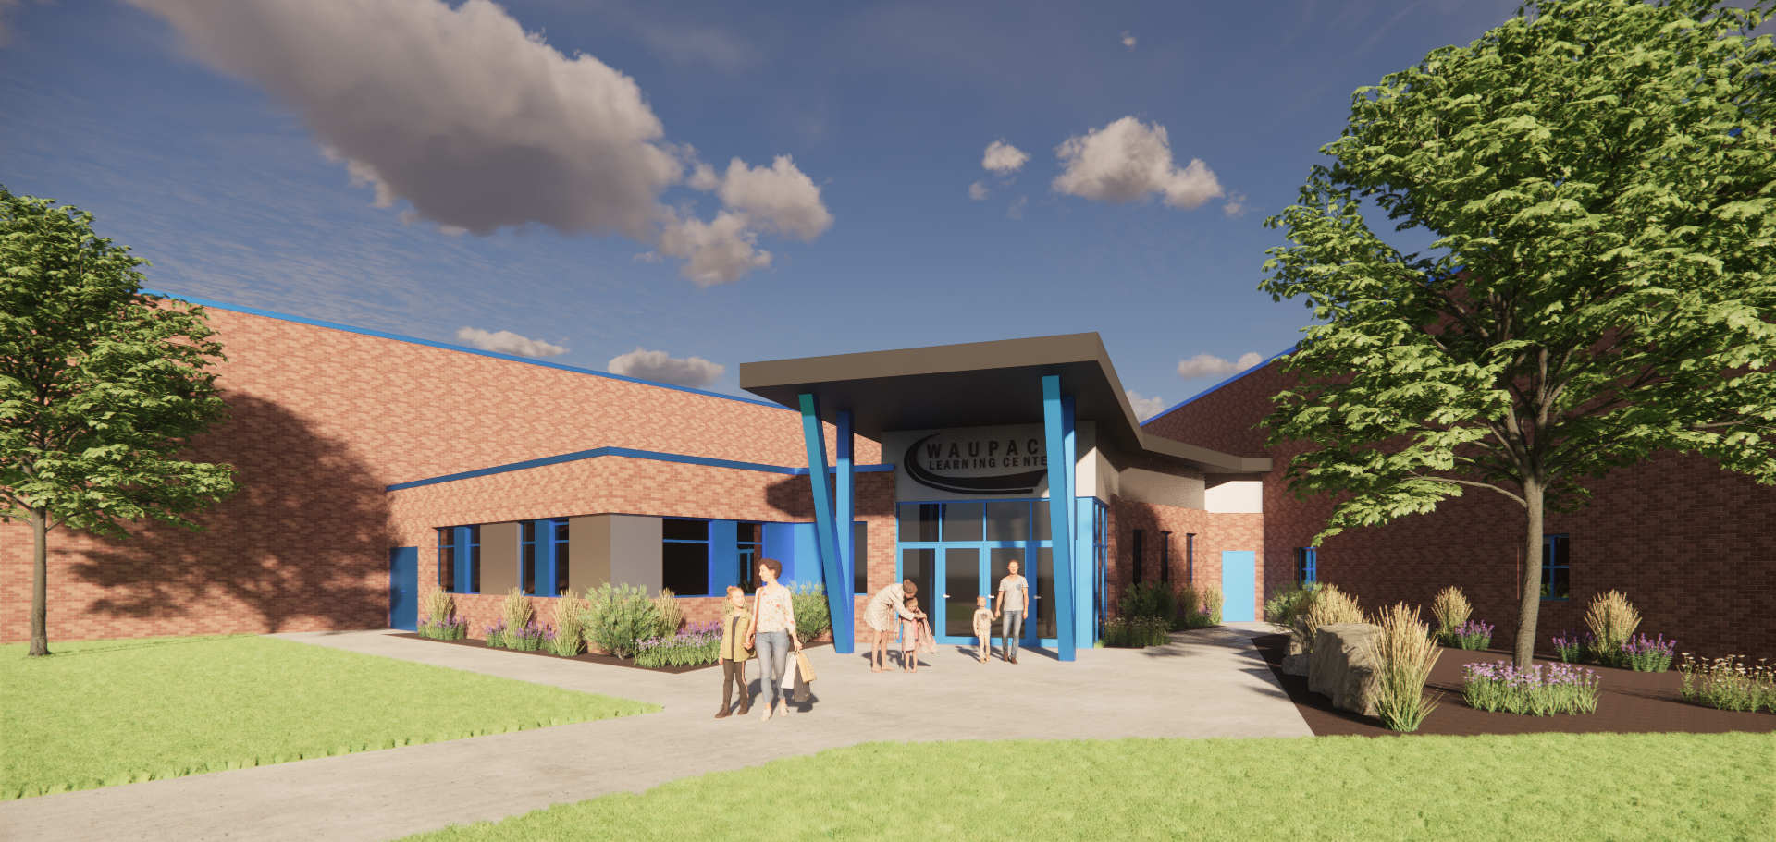

Slide 30
Middle School

Slide 33
High School

Slide 34
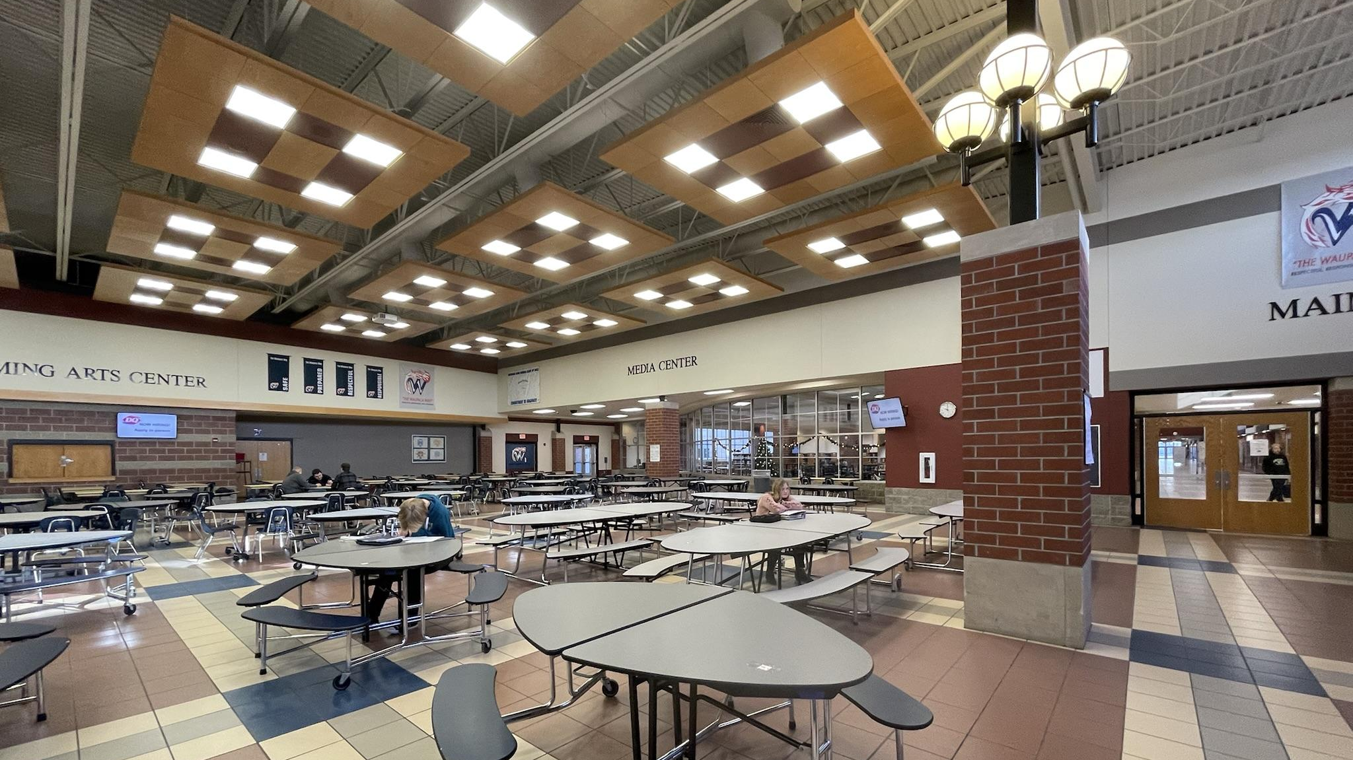
WAUPACA HIGH SCHOOL
Notes:
Steve

Slide 37
CEC

Slide 38
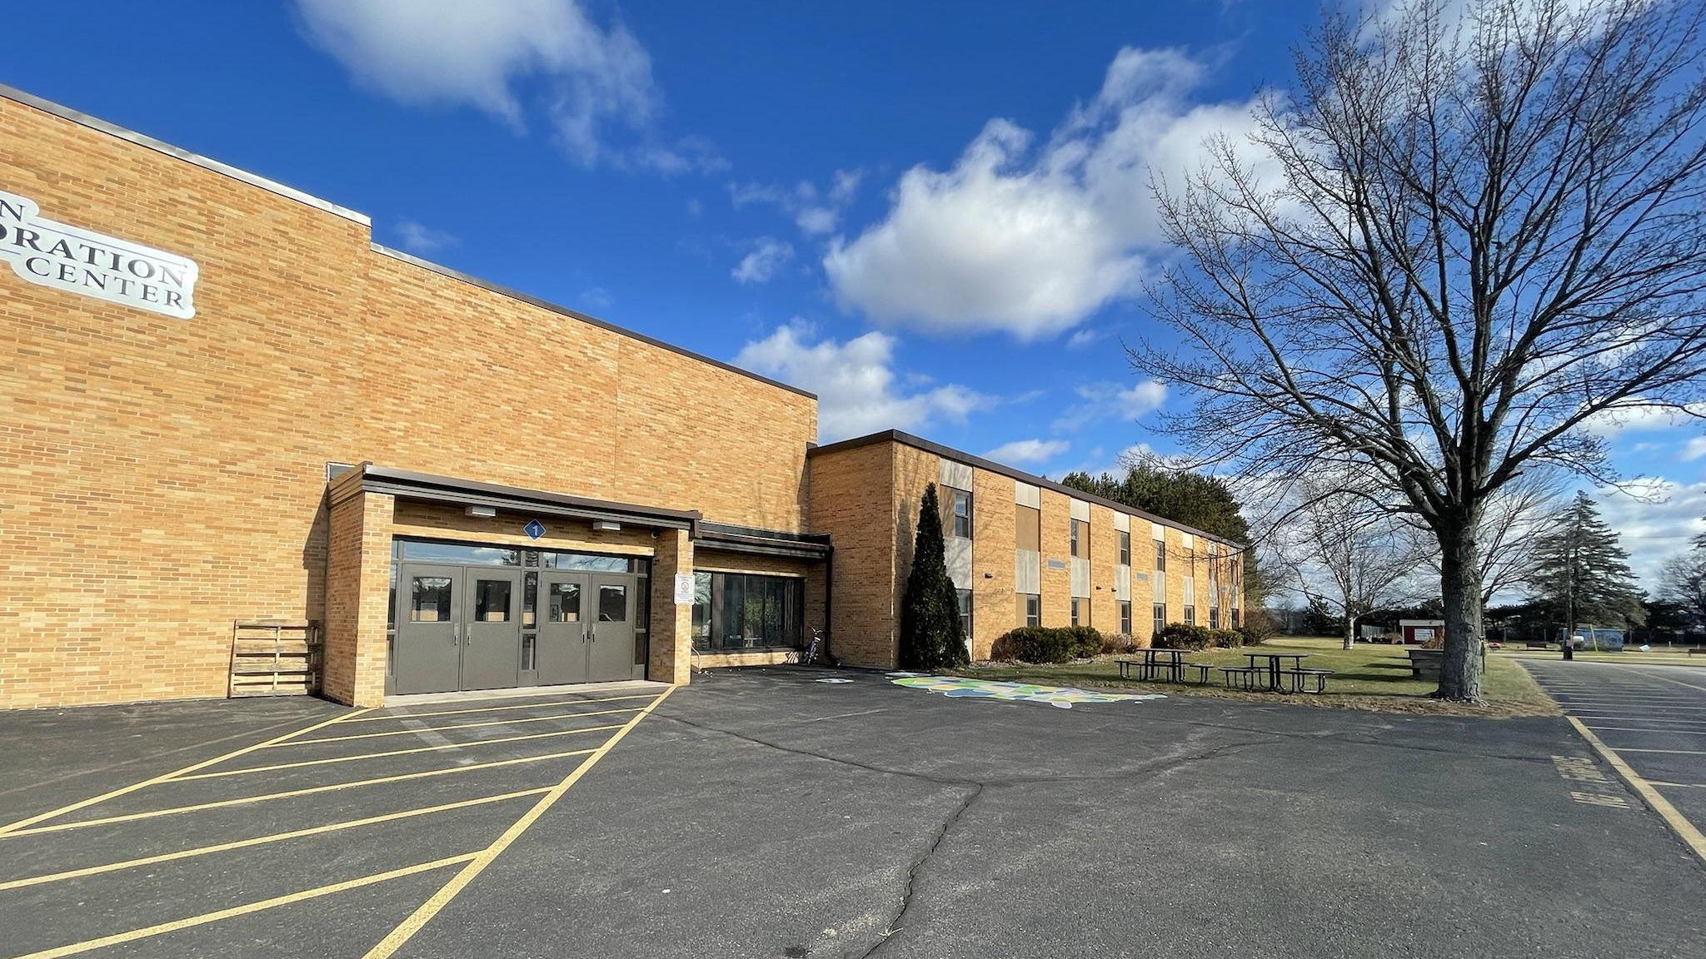
CHAIN EXPLORATION CENTER
Notes:
Molly

Slide 41
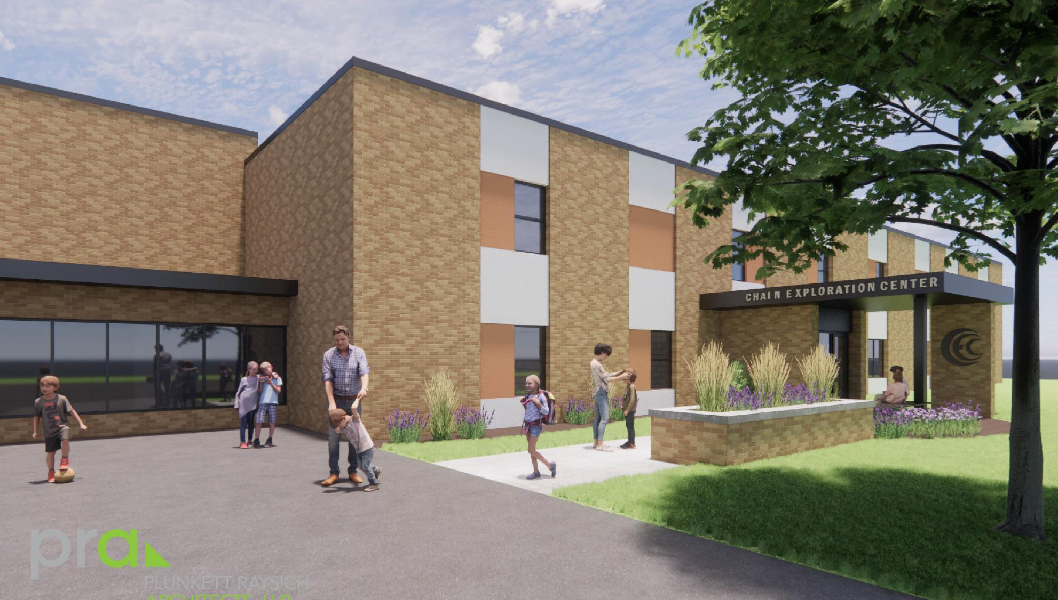

Slide 42
The District is
Good Fiscal Stewards of
Taxpayer’s Money

Slide 43
The district has been good fiscal stewards of the districts taxpayers’ money such as taxing under the revenue cap 9 years in a row saving the taxpayers over $16 million dollars.
Unlike other districts Waupaca hasn’t come to the taxpayers over and over with referendums to repair its infrastructure for we methodically follow the districts strategic long term infrastructure replacement plan investing over $2.5 million each year being part of our budget not an afterthought of letting roofs and internal HVAC components go until their broken and then ask the taxpayers for new ones.
We built an award winning athletic complex through donations and district funds and the selling of property rather than seeking a referendum.

Slide 44
We have managed our 2nd biggest fund 10 budget item which is health insurance arguably the best in the WI public school world over the last 11 years negotiating renewals that are less than in 2010 saving the district over $1.7 Million dollars creating a capital position that avoids short term borrowing increasing the districts net equity,
The native Americans have a saying “We only take what we need” which has been part of this districts fiscal framework and fiscal belief in making sound fiduciary decisions for all the stakeholders we have the privilege to serve.
The last time this district sought a referendum was over 22 years ago in which the taxpayers approved overwhelmingly the building of a new high school and renovation of the middle school and WLC. Since then we have taken immaculate care of these wonderful facilities our taxpayers have provided to serve their children.

Slide 45

We have not asked for referendums to upgrade our internal or external infrastructure we have and continue to take care of this annually within the district budget. We have not asked nor will we be asking to exceed the revenue limit for operating expenses that we believe should be taken care of with our annual taxpayers monies allotted to us by law.
We haven’t come to the public to seek building new gymnasiums , new buildings or total demolition of buildings and building completely new for we take care of what the taxpayers have given us and with the majority of WI public school districts facing declining enrollment how wise would that be of the district use of district taxpayers monies anyways?

Slide 46
Our debt is paid off, our mortgage payment is over if you will for the last referendum 22 years ago.
30 years ago building designs weren’t thinking of safety so much in both the private and public sector rather the thinking was more aesthetic in design emphasis.
Now, 3 decades later the world has changed and the point of entry in both the private sector (hospitals, offices etc.) and the public sector (schools, government buildings) for the protection of their patrons and stakeholders have developed true infrastructure design solutions to mitigate for lack of a better word societies violence and discordant elements from entering facilities that are supposed to teach and protect the most innocent of our society, children.

Slide 47

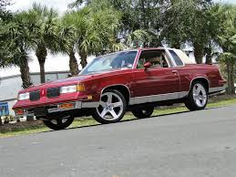
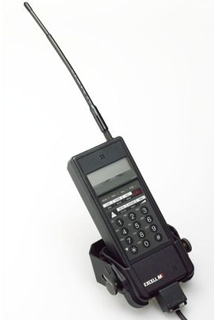
30 years ago
Computers, Autos, Cell Phones

Slide 48
Our Current entryways,
How they look now need to be different.
If not today, when?
Why would we wait?
This district will do this at some point in time regardless, this security breach won’t fix itself and it is not going away.

Slide 49
Point of Entry is this districts most vulnerable area of concern according to the WI School Safety Coordinators Association and the Department of Justice and we need your help.

Slide 50
The Method of Achievement
The Wisest Use of Managing Taxpayer dollars long-term

Slide 51
Good Fiscal Stewards of Taxpayer’s Money
After exploring multiple options of what is best for all the stakeholders to fund the district’s commitment to ensuring the district is doing all that is possible to mitigate physical harm to students, staff, and community members with a minimal tax impact in the shortest time fiscally manageable to maximize general state aid in conjunction with the district’s financial advisor I have come to the following conclusions.
The building entryways need to be remodeled or renovated according to PRA’s designs as soon as fiscally possible
Revenue Limit funding constraints do not allow the district the capacity to take $3,875,000 from the overall general fund instruction budget.

Slide 52
Using any fund balance would be detrimental to the organizations net capital position and could be depleted in a few years (although it is in a solid position currently). Wise economics with ever increasing budgets prove fund balance should be increased each year rather than depleted which is in accordance to the district’s Strategic Plan. Using fund balance could cause the district to short term borrow in a few years losing instructional dollars to paying ever increasing interest rates if used potentially needing to come to the public with referendum’s to exceed the revenue limit in a few years which would be short sighted a fiscally long-term disaster. Avoid this at all cost for future boards, administrators and taxpayers.

Slide 53
The most fiscally prudent mechanism, and remember the School District of Waupaca hasn’t come to the public for over 22 years is to attain public support through the legally allowed process of requesting our taxpayers of this one-time safety remodeling renovation project of $3,875,000 which is a long-term investment, is a referendum for this sole purpose.
After reviewing the financial options to this regard as the Financial Advisor to the Board of Education it is my recommendation after careful financial considerations to seek a referendum for $3,875,000 in November of 2022 for this project. In reviewing the overall long term cost and the length and the potential new debt placed upon our distinguished taxpayers (which will be the only debt obligation the district will have) it is my recommendation to take the shortest amount of time possible to pay this new debt off which is 10 years. The projected tax impact for taxpayers tax mill rate would be 13 cents per 1000 of property value or for example $13 annually for a home valued at $100,000, $26 annually for a home valued at $200,000. Meaning a $200,000 home property value homeowner would pay over a 10 years period $260 or $26 per year.

Slide 54
Types of Referendums:
In April of 2022 WI Public Schools held 81 referendums for various reasons such as this:
Exceed revenue limit for non-recurring purposes consisting of maintaining educational programming, technology, and facilities - $5.2M (Ellsworth)
4 yr. referendum to exceed the revenue cap. 2022-23 1,200,000, 2023-24 1,200,000, 2024-25 1,400,000, 2025-26 1,600,000 - $5.4M (Fontana)
Exceed revenue limit for 3 years for operational expenses - $4.95M (Rio Community)
To exceed the revenue limit – is an indication that these districts can’t keep up with normal expenses. It is not for a defined purpose. When districts have let their infrastructure go not continuing to strategically fix maintenance components or have failed to manage their salary and health insurance expenses this is the type of referendums districts seek sometimes stacking one on top of the other.

Slide 55
The other type of referendum is for Capital Projects such as this.
Borrow $119,800,000 to fund district-wide safety and security, school updates, building infrastructure, capital maintenance and site improvements; remodeling at all middle and high schools; construction of additions at Horace Mann and John Muir Middle Schools, West and East High Schools and Grant, Riverview, South Mountain and Stettin Elementary Schools; construction of a new School Forest Environmental Learning Center; and acquisition of furnishings, fixtures and equipment. - $119,800,000M (Wausau)
Issue general obligation bonds in an amount not to exceed $15,600,000 for the public purpose of paying the cost of school facility improvement project consisting of: construction of an addition, renovations, safety and security improvements, building infrastructure and site improvements at the Elementary School; renovations, safety and security improvements, accessibility updates, and building infrastructure, site and outdoor athletic facility improvements at the Middle/High School; and acquisition of furnishings, fixtures and equipment. - $15.6M (Wild Rose)
65 of 81 WI public school district referendums (80%) passed this past April. Most were vaguely defined.

Slide 56
The referendum I am recommending the board seek is one for a specific defined purpose.
Safety. Its 13 cents or $13 annually for a home valued at $100,000 or $130 over a 10 year period.
The district will be in and out of this debt obligation in 10 years not 20 years.
This is what I am advising for it will not harm or increase the districts normal source of expenses which include all facility repairs internally at a cost of approximately $2.5M each year, this is solely for the Building Safety Remodeling and Renovation ONLY as recommended by the Wisconsin School Safety Coordinators Association and the Department of Justice.

Slide 57
Taxpayer Safety Investment

Slide 58
Fiscal Due Diligence
Requires
Pausing – What is the in the long term best fiscal interest for the district and taxpayers
Looking Forward - at all future fiscal obstacles which is wise use of taxpayer dollars
Preparing – for inflation, project cost overruns and the uncertainty of future State Budgets
In Looking to the Long Term Fiscal Future of Inflation & Cost Overruns and Limited State Budgets I have concluded it is in the best interest for both the district and taxpayers to the hold the funds designated for this purpose for the above and following reasons.

Slide 59
I am recommending as your financial advisor to leave this money in capital projects funds rather than use it for this purpose. In a volatile inflationary market with expenses in all areas of the district budget going up possibly 7% while the revenue limit at best goes up 1% makes me pause looking to the future.
Wise use of this money would be to hold it to supplement any cost overruns for this project rather than ask for a larger referendum. If indeed the budgeted project comes within the lines as projected just as with the use of the $1M dollars earmarked out of ESSER III funds to supplement the district’s annual investments in component, roof and HVAC replacements for example which total cost is approximately $2.5M each year (see long term facility maintenance strategic plan) we can bridge this gap in funding not letting our crucial infrastructure ongoing needs falter. Inflationary numbers are showing us that we need to be prepared for the long run and the $1M which was earmarked for safety remodeling renovation if not needed for cost overruns fills the financial gap to supplement our maintenance and facility needs offsetting these cost within the overall budget. January of 2022 cost estimates for this entire project was $3,440,000 in late April of 2022 cost estimates are now $3,875,500, $435,500 higher. The difference between borrowing $2,875,000 versus $3,875,000 is 3 cents per 1000 of property valuation.
Being fiscal stewards of taxpayer’s money the public expects us to think ahead preparing for coming expenditures that will require our attention placing the district on sound financial footing in a volatile economic time that is riddled with part and component shortages which are driving costs higher. Wise organizations take a step back and regroup getting the most out of all assets limiting their liabilities.

Slide 60
The Financial Solution

Slide 61
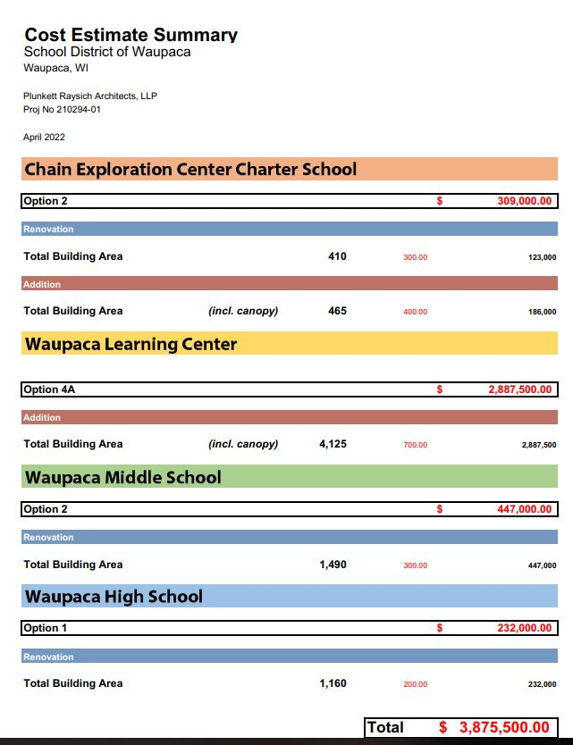

Slide 63
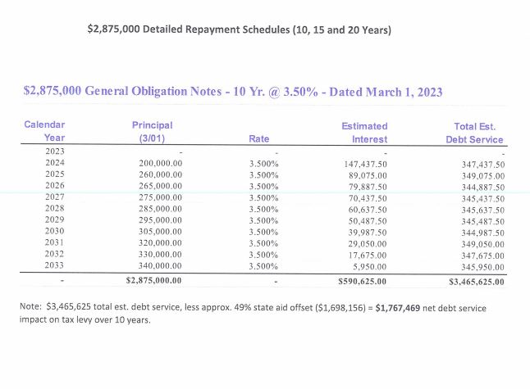
The difference between borrowing $2,875,000 versus $3,875,000 is
3 cents per 1000 of property valuation.
$2,875,000 Scenarios (Not Recommended)

Slide 64
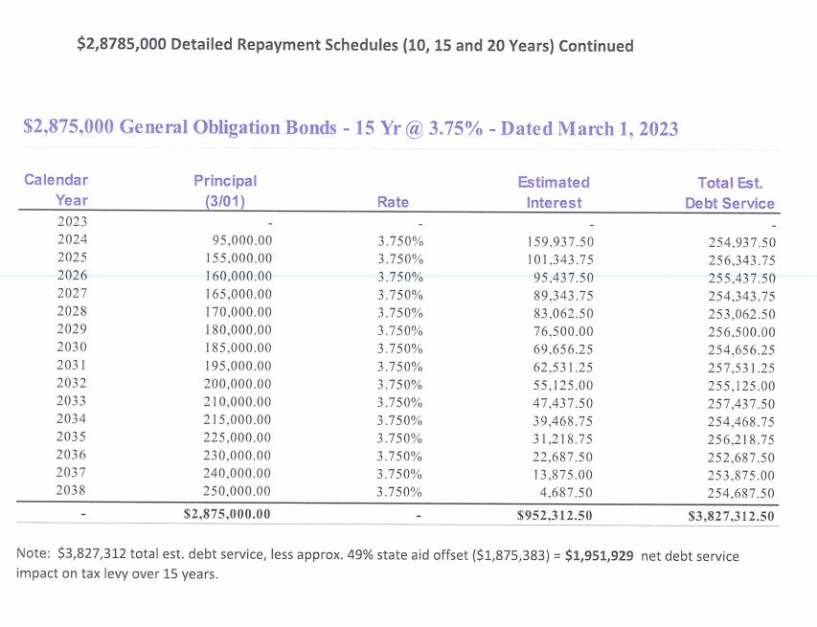

Slide 65
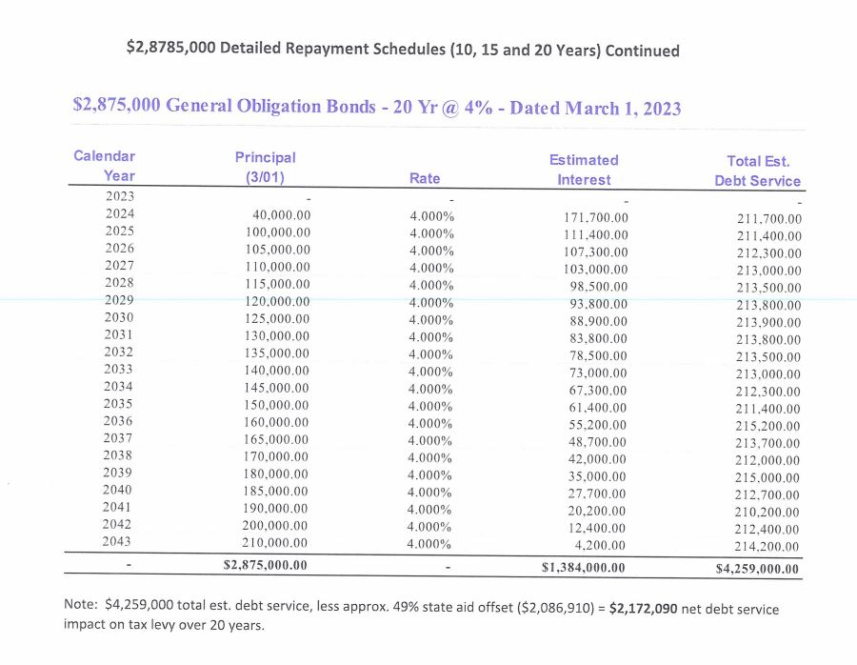

Slide 66
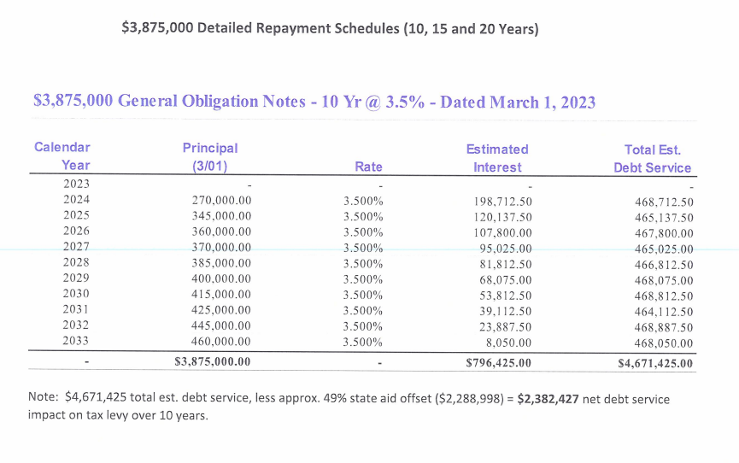
$3,875,000

Slide 67
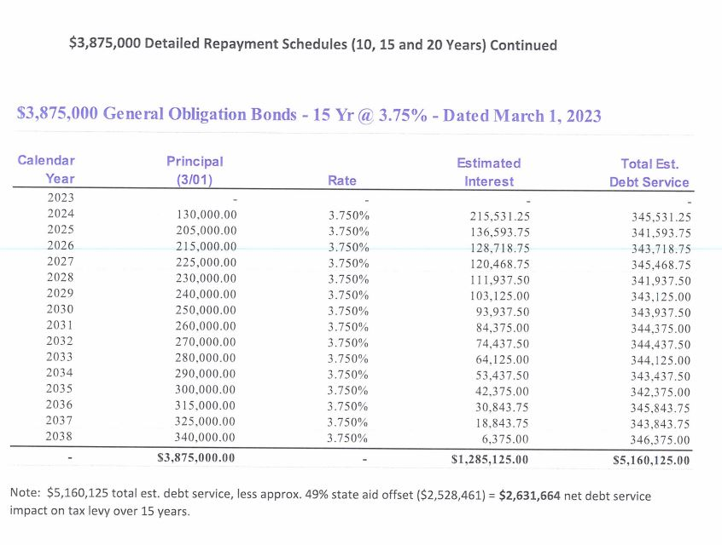

Slide 68
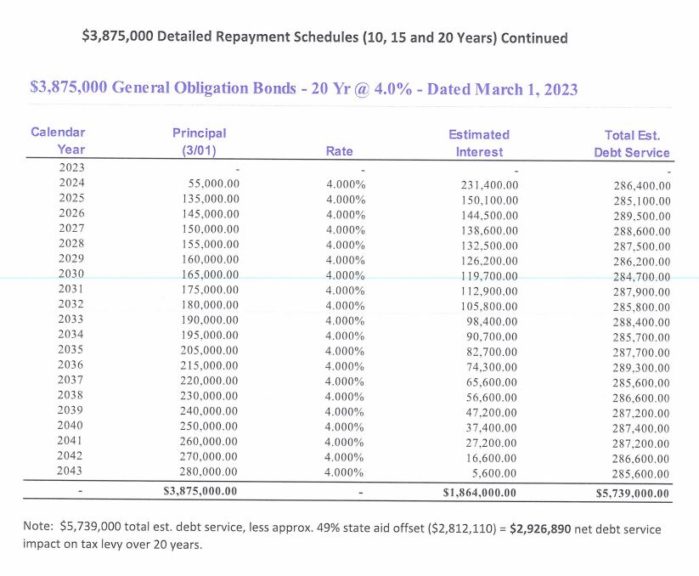

Slide 69
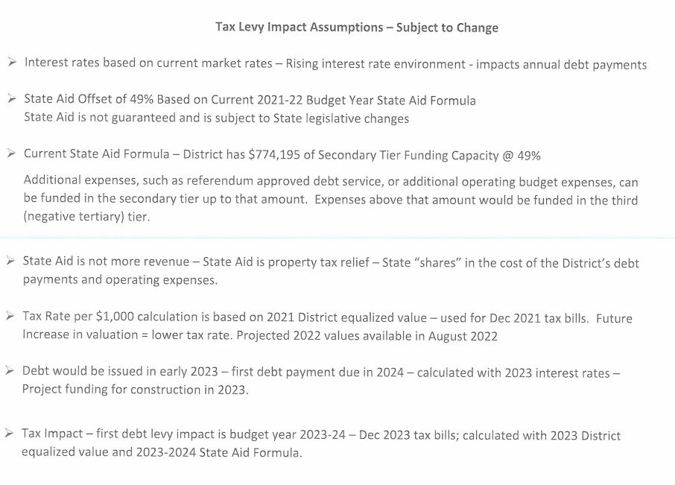

Slide 71

Just imagine what would happen if your daughter was standing there. What would you do, how would you fight? So you have to join hands, you have to take each child as your daughter. Soon you will feel their sorrow and then you will feel the strength that comes out of you to protect them.
Anuradha Koirala

Slide 72
This should be a unifying experience of pulling together our community for a common purpose of love and safety for our children.
  To me this is not a partisan issue and has nothing to do with politics regardless of what one’s individual political ideologies are.
      All parents, and community members collectively desire the protection of their children and our duty as an organization is to provide this to the best of our ability.
Notes:
Tip:
When using complex image as full-bleed background add a transparency (70%-90%) fill layer to give contrast to text.

Slide 73
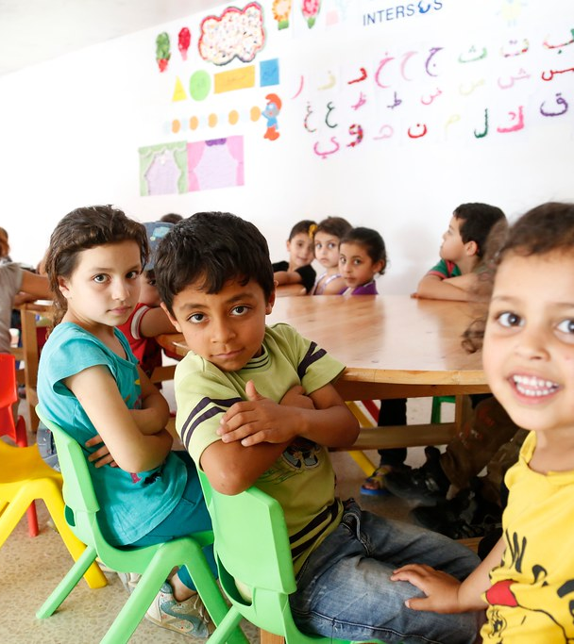
If What's holding you back from approving this project
Is Fear of Failure
    Fear Not
    Love is greater than fear

Slide 74
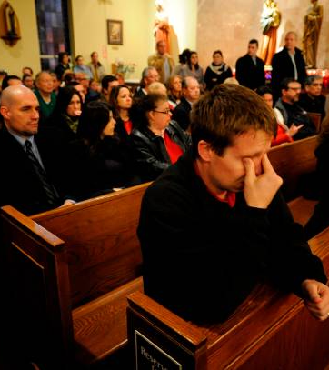
This is about the love & safety of all children and staff and community members and taxpayers
Keeping those we love from the harm of violence
Keeping those we love from predators
Paying it forward for future generations safety
Notes:
Combine an image and multiple key statements with a strong grid.

Slide 75
Its Safety Protocol
Its Point of Entry
YES
Neal Creative | click & Learn more

Slide 76
Recommendation
The district authorizes a referendum for $3,875,000 million dollars for all school building entryways to be remodeled or renovated for safety & security purposes working with Wisconsin Public Finance President Carol Wirth to direct and complete the financial portions of this project including formulating the referendum resolution language to be on the ballot on the November 2022 general election.
The School District of Waupaca authorizes PRA to continue to complete their architectural work completing their design work inclusive of managing and fulfilling all bidding of materials and labor associated to complete this project.

Slide 77


